Slide 1
Temporal Video Tracking
By John Drogo
By John Drogo

Slide 2
Overview
Problem Statement
Background
General Concepts
Solution Architecture
Results

Slide 3
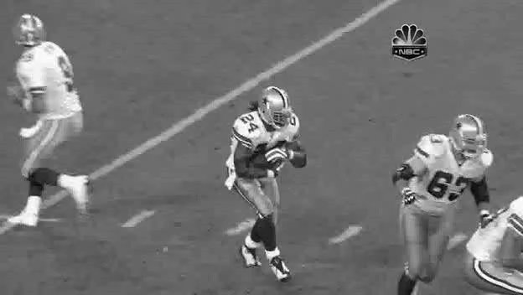
Problem Statement
Track an object through a video sequence.
Occlusion
Complex Background
Object motion/rotation
Multiple targets
Noise artifacts
Changing features

Slide 4
Background
Literature survey to understand existing methods
Widely varied, examined approaches include:
Structured Output Tracking with Kernels (STRUCK)
Kernelized Correlation Filter (KCF)
Minimum Output Sum of Squared Error Correlation Filter (MOSSE)
Common ground
Identify features of interest
Predict how the features change
Look for the features in new frames

Slide 5
Solution Architecture
Three stage approach
Feature Detection, Classification, and Prediction
An initial truth frame of the target is provided to prime the tracker
For subsequence frames the tracker draws a boundary box around the target
Developed with OpenCV
High performance video manipulation framework

Slide 6
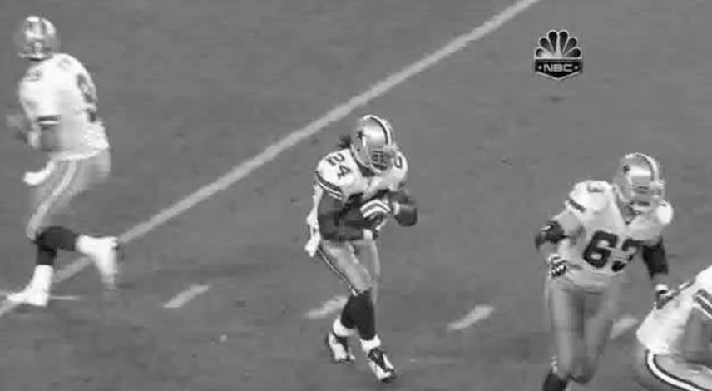
How to Build a Tracker
Input Data
Feature Detection
Classifier
Prediction

Slide 7
Feature Detection
Correlation Filter
Detects similarity between the video frame and a “kernel”
Correlation in the spatial domain becomes multiplication in Fourier domain
Two kernels are processed
A “positive” kernel based on last known match
A ”negative” kernel based on surrounding known bad tiles
Uses the linearity of convolution to combine both into one operation
The separation helps the tracker to suppress complex background clutter
Raw correlation scores are weighted and used for classification

Slide 8
Feature Classification and Prediction
The highest score is classified as the target
The updated position is fed into the smoother
The smoothed location adjust the Gaussian weights in the detector
Matches closer to the predicted location are weighted heavier
Kalman Smoother
Estimates the state of the tracked object (position, velocity)
A constant acceleration two-dimensional Kalman filter was used
The smoother permits prediction of the target’s position in the next frame
Tunable between smoother and more responsive tracks
Weighted Correlation Score (White is Higher)

Slide 9
Kalman Prediction
The Kalman filter is used to smooth detected position
This position is used to focus in on the predicted search area helping to discern background clutter in complex environments
The smoother also permits coasting during track break
Prevents track steals when target is partially covered
The filter is implemented in two stages
Predict – Uses the internal state to generate a prediction for the next frame
Correct – Updates the internal state based on the observed measurements
The filter must be calibrated to the expected motion of the scene
If the process noise is too low the smoother will not lock
Too high and track steals become frequent

Slide 10
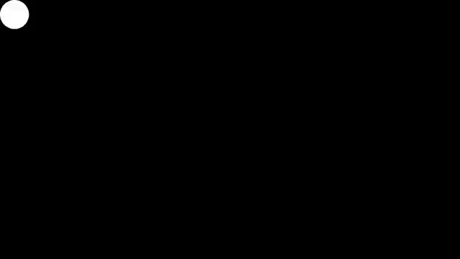
Verification
Literature survey revealed a tracker testbench
Several example clips were extracted to validate algorithm
A set of simpler test clips were used to assist development

Slide 11
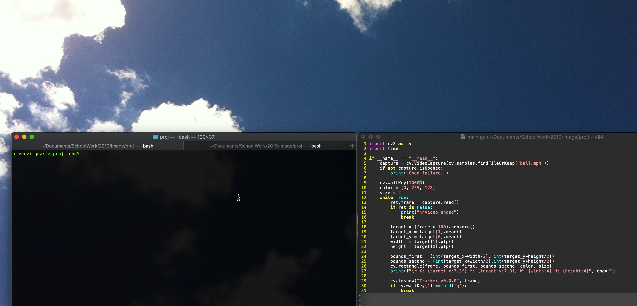
Hello Word – v0.0.0

Slide 12
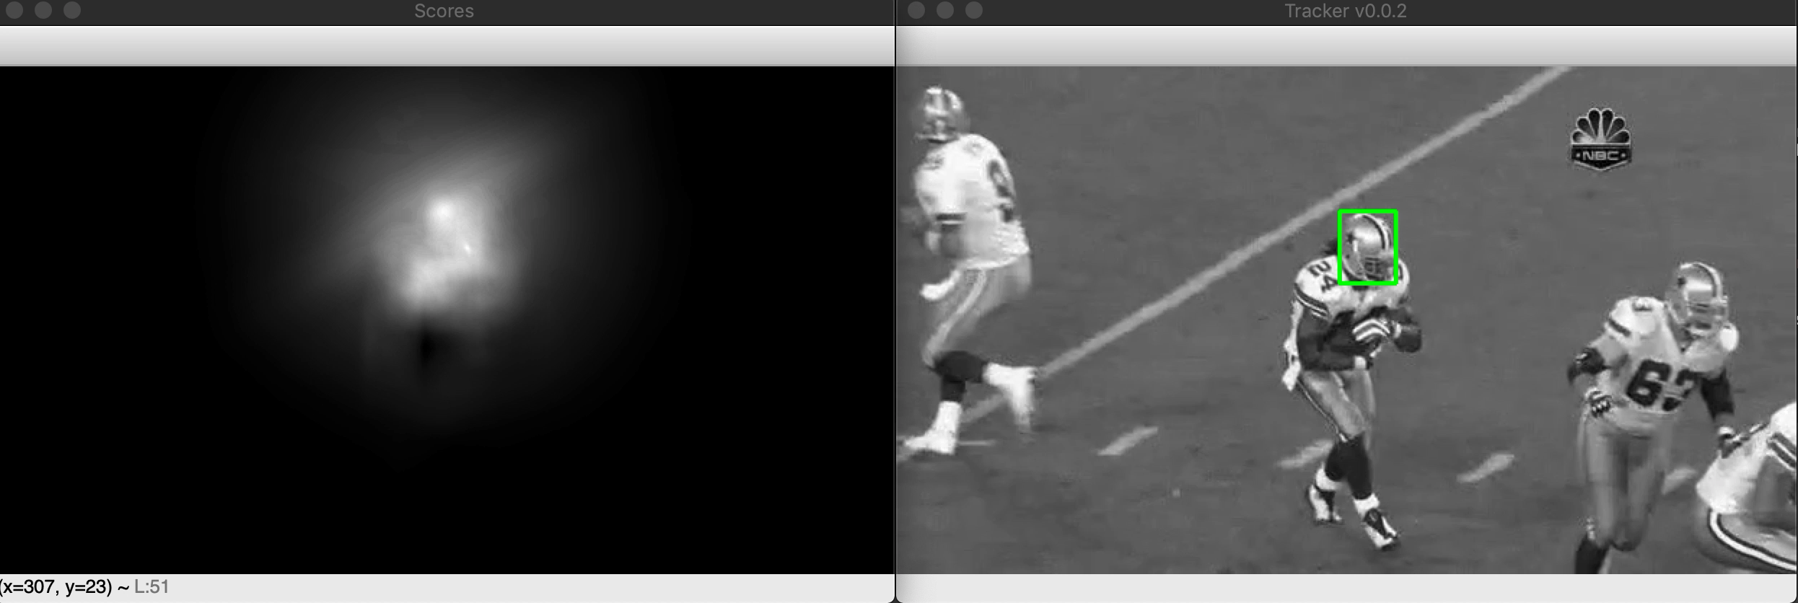
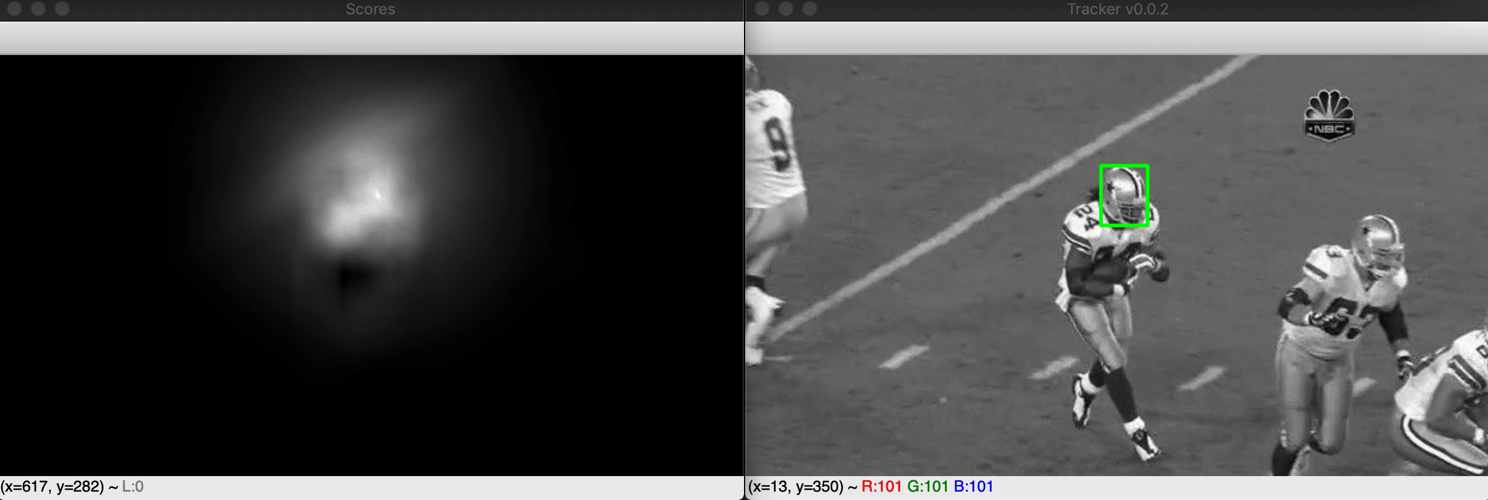
Algorithm Refinements
Learning Rates
Update kernels based on observed samples.
Kalman Tuning
Calibrate process noise and weight distribution.
Two stage focus
Wide area adjusting based on correlation lock.
Gain for predicted region.
Lost lock fallback
Auto target re-acquisition
After Kalman Tuning
Before Kalman Tuning

Slide 13
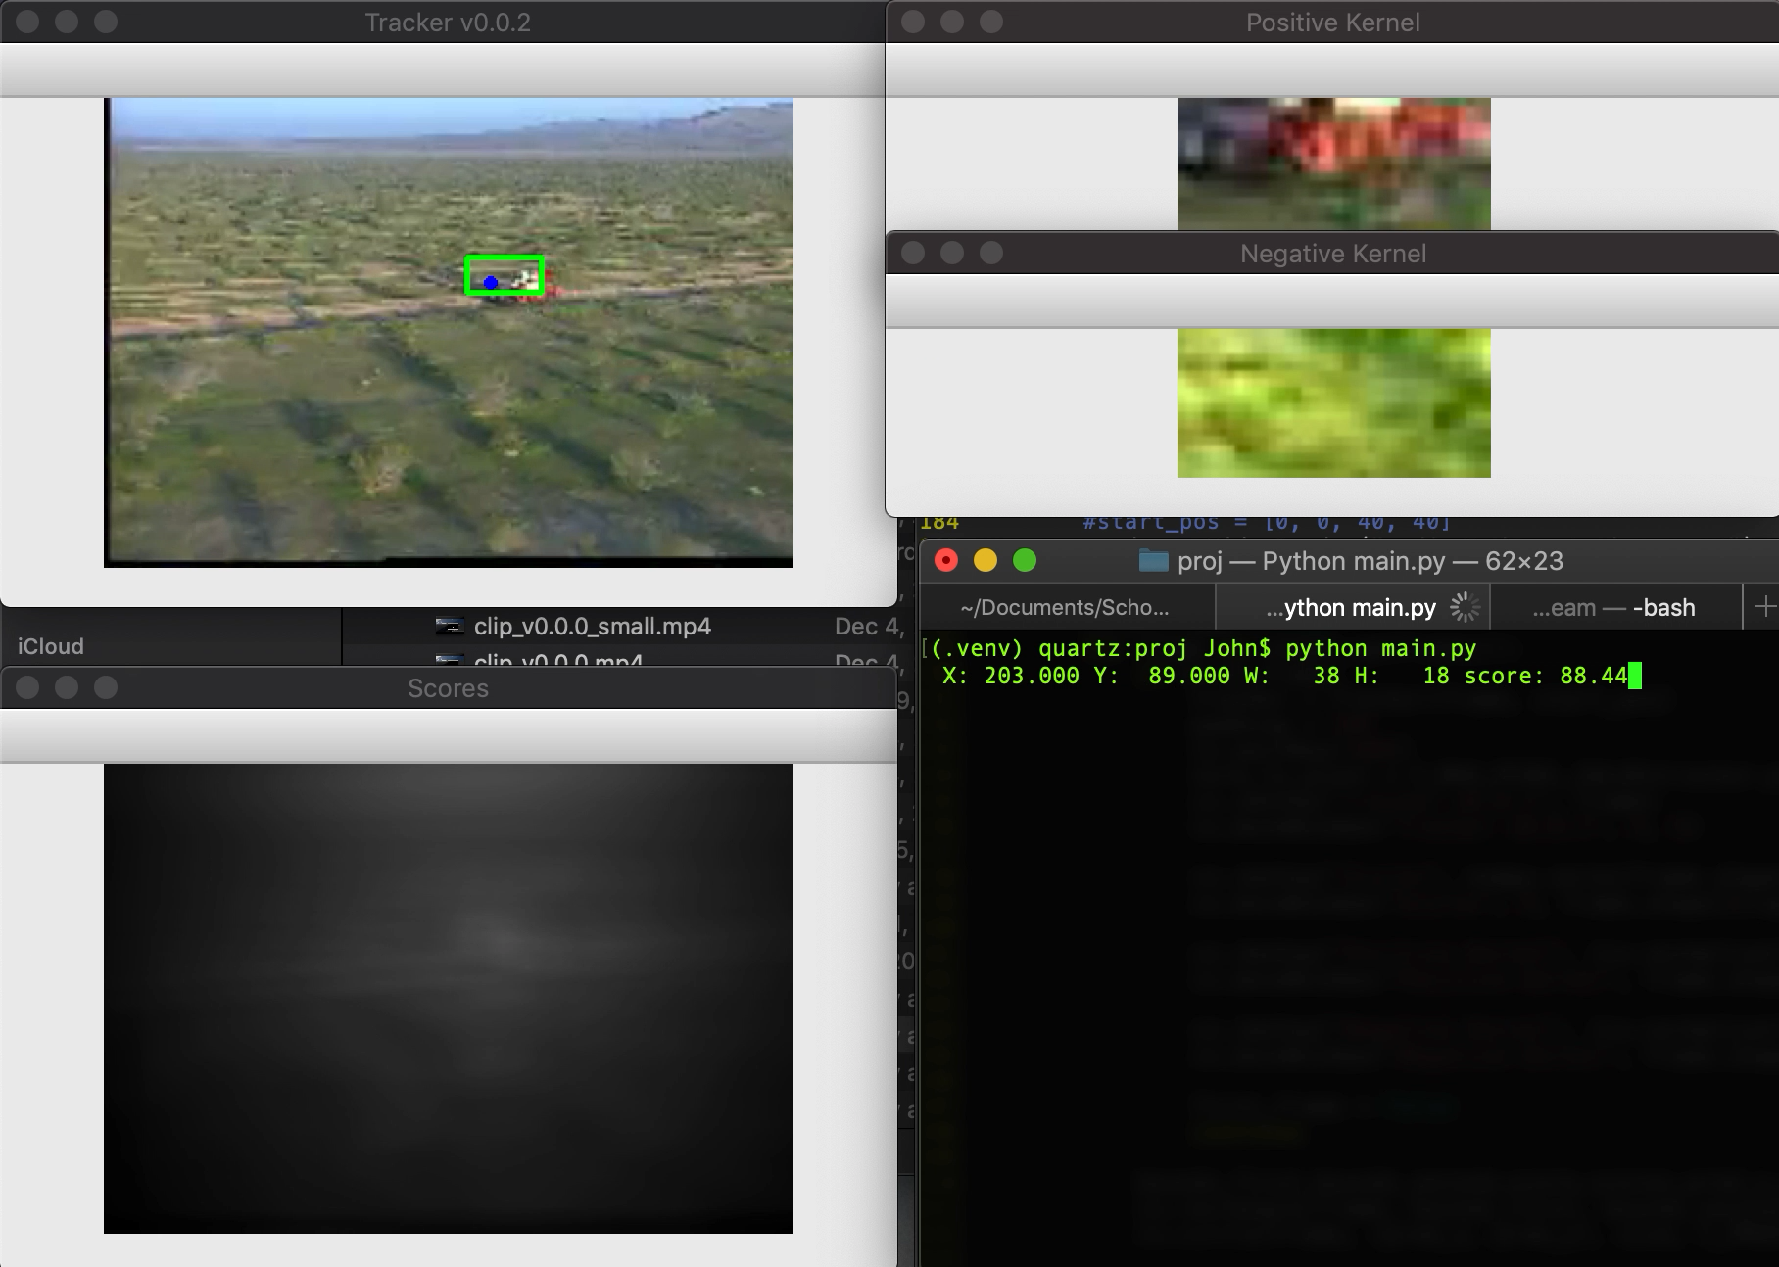

Slide 14
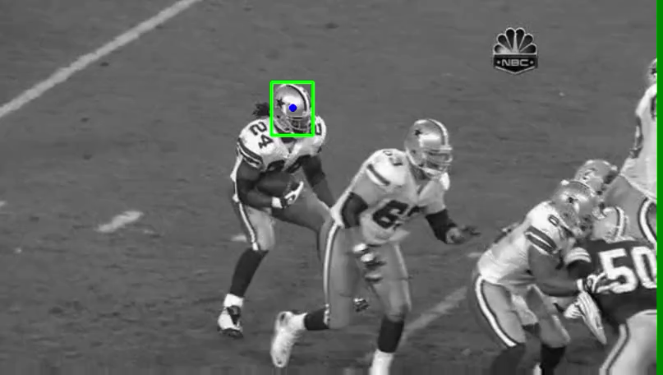
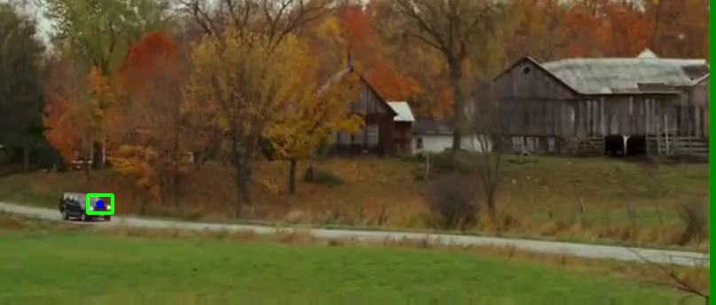
Summary
Successful tracking
Reasonable performance with common configuration
Sensitive to camera motion
Affects Kalman Estimation
Profile changes are difficult
Faster learning rate makes system susceptible to clutter

Slide 15
Questions?
https://github.com/skhobahi/Kalman-Filter-Object-Tracking/blob/master/Object%20Tracking%20Using%20Kalman%20Filter.pdf
https://www.opencv-srf.com/2018/03/gaussian-blur.html
https://opencvexamples.blogspot.com/2014/01/kalman-filter-implementation-tracking.html
http://www.robots.ox.ac.uk/~joao/publications/henriques_tpami2015.pdf
http://setosa.io/ev/image-kernels/
https://ieeexplore-ieee-org.proxy1.library.jhu.edu/stamp/stamp.jsp?tp=&arnumber=7360205&tag=1
https://www.cs.colostate.edu/~vision/publications/bolme_cvpr10.pdf
https://faculty.ucmerced.edu/mhyang/papers/cvpr13_benchmark.pdf

